Slide 1
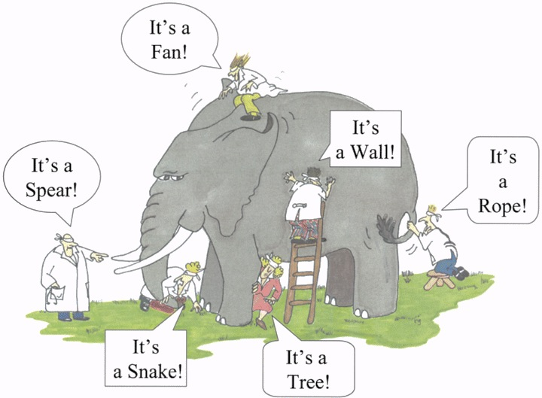


On Blind Mice and the Elephant
Understanding the Network Impact of a Large Distributed System
John S. Otto, Mario A. Sanchez, David R. Choffnes*, Fabián E. Bustamante, Georgos Siganos**
Northwestern, EECS
* U. Wash, CSE
** Telefónica Research

Slide 2



Several elephants of the Internet
A large, global peer-to-peer system
Millions of users exchanging content
Virtually every country in the world
Notes:
Elephants are widely distributed systems with diverse usage patterns depending on location.

Slide 3
Perspectives on distributed system measurement
System’s measured network impact depends on measurement vantage point
  How much of network traffic is from BitTorrent?
Germany
37% (ipoque)
Eastern Europe
57% (ipoque)
No, Germany is 9-15%
(Maier et al. IMC’09)
South
America
20% (ipoque)

Slide 4
Approach to evaluating system impact
A view from a broad set of end users
  To sample its overall network traffic
  Understand where it flows
  Who pays for it (and how expensive it is)
This work
  Relies on end users as vantage points
    Captures a sample of all BitTorrent traffic
    Reveals traffic’s path through the network
      Public view is not sufficient to map most BitTorrent traffic
  ISP data provides context to understand cost of BitTorrent traffic

Slide 5
Our diverse end-user perspective
Representative sample of users
  500,000 users, 3,300 networks, 169 countries
Running extensions (Ono & NEWS) for Vuze BitTorrent client
  Anonymously report statistics
  Provide application-level data
    e.g. session length, per-connection transfer volumes
    Log 13 TB of traffic per day
  Conduct active measurements to reveal traffic paths
    With public view alone, we can map 25% of traffic
    Supplemented with traceroutes, we can map 89%

Slide 6
Roadmap
How BitTorrent is being used
  Who is using BitTorrent?
  When do people run BitTorrent?
  How much traffic does it generate?
  Study data from Nov. 2008 to Nov. 2010
Where the generated traffic flows
Who pays for it and how much

Slide 7
BitTorrent trends: user population
Overall population reduced by 10%
Locations of users change over time
Connected peers
by continent
2009
2010
Decrease in Europe
Increase in Asia, Africa and Oceania

Slide 8
BitTorrent trends: user population
Rate of growth of connected users per continent relative to Nov. 2008
Europe continues to drop
N. America, S. America remain stable since 2009
76% growth in Africa and 47% in Asia

Slide 9
BitTorrent trends: stronger diurnal patterns
European peers seen on weekdays
Normalized number of peers seen per hour in Europe, depending on time of day
Shift away from overnight use
Peak usage aligns with evening hours, local time
  Potential impact on ISPs’ costs under burstable billing

Slide 10
BitTorrent trends: increased traffic volumes
Per-peer hourly download volume (in MB) over the last year
25% increase in per-peer hourly download volume
Despite a 20% drop in total connections, a 12% increase in overall system traffic

Slide 11
Trends in BitTorrent usage and traffic
Overall population reduced by 10%
  But large increase in Africa and Asia
Peak usage aligns with evening hours
  12% increase in overall system traffic
  25% increase in per-peer hourly download volume
So where’s the traffic?

Slide 12
Where BitTorrent traffic flows
How “deep” does traffic go in the network?
Who is paying for it?
Traffic path analysis to see which networks carry most BitTorrent traffic
  Tier 1: Well-known networks
  Tier 2: Large transit providers
  Tier 3: Small transit providers
  Tier 4: Content/access/hosting providers
  Enterprise customers
Tiers based on Dhamdhere and Dovrolis, IMC 2008

Slide 13
Traffic’s “depth” in the network
Smaller
fraction
of traffic
Fraction of each peer’s traffic that reaches Tier X
Most traffic stays at or below Tier 3
Significant fraction of traffic never reaches Tiers 1 or 2
  Typically missed by in-network monitoring studies from the core

Slide 14
Endpoints’ tiers determine “depth”
Traffic from Tier 2 to Tier 2
Traffic from Tier 3 to Tier 3
Traffic generally stays in the originating tier
Tier 2 networks do not provide “intermediate” level of connectivity between Tiers 1 & 3

Slide 15
Roadmap
How BitTorrent is being used
Where the generated traffic flows
  Most traffic is handled at or below Tier 3
Who pays for it and how much

Slide 16
Economic implications for ISPs
Determine BitTorrent cost relative to other traffic
  ISP X’s data provides context to interpret traffic sample
Study at granularity of individual network links
Consider common burstable billing model
  e.g. 95th-percentile billing
Data for several
of ISP X’s links
over 1 week
Providers
Customers

Slide 17
95th-percentile billing
Aggregate link volume for each 5 minute bin
Cost is based on 95th-percentile bin’s value
Under burstable billing model, not all bytes may have the same cost
  Peak-hour bytes are more expensive than off-peak
When value is defined
95th-percentile value
All
Traffic

Slide 18
95th-percentile and Shapley value
BitTorrent peaks at 3AM
BitTorrent’s
contribution
to cost
BitTorrent peaks at 9PM
Other
BT
BT
Other
Other
BT
Other
BT
BitTorrent at peak hour is more expensive
Use Shapley value to determine relative cost of BitTorrent
  Shapley value gives the cost contribution of BitTorrent traffic
  Compare to other traffic on the network
  Is BitTorrent’s cost more than its “fair share” by volume?

Slide 19
Relative cost of BitTorrent traffic
Additional cost of BitTorrent traffic, percent above relative cost of 1
BitTorrent traffic is generally more expensive than other traffic
What traffic characteristics result in high relative cost?

Slide 20
Traffic characteristics and relative cost
Out-of-phase peaks
Aligned peaks
Small
peaks
Large
peaks
High relative cost of BitTorrent
  Large coefficient of variation (“C.V.”, size of peaks in BitTorrent traffic)
  Small cross-correlation offset (“X-corr”, alignment with overall traffic)

Slide 21
Traffic characteristics and relative cost
Out-of-phase peaks
Aligned peaks
ISP A
X-corr: -7.1 hours
C.V.: 130%
Relative cost: 13%
ISP E
X-corr: 1.6
C.V.: 158%
Relative cost: 83%
Small
peaks
ISP F
X-corr: 7.4
C.V.: 325%
Relative cost: 52%
ISP B
X-corr: 3.2 hours
C.V.: 188%
Relative cost: 50%
Large
peaks
High relative cost of BitTorrent
  Large coefficient of variation (“C.V.”, size of peaks in BitTorrent traffic)
  Small cross-correlation offset (“X-corr”, alignment with overall traffic)

Slide 22
Conclusions
BitTorrent is still alive and costly
  Most traffic stays at the edge of the network
  It is moving into prime-time
  Logically, it is relatively more expensive
A broad view from the edge of the network is required to see the system’s full usage spectrum
Approach is general to understanding other distributed systems
  Video streaming
  Peer-to-peer CDNs

