Slide 1

The Hidden Locality in Swarms
John S. Otto
Fabián E. Bustamante
Northwestern U.
Notes:
Target: 15 min + 5 min for Q&A

Slide 2
Locality in P2P systems
Avoid cross-ISP traffic
Better performance
Lower ISP costs, reduced peering link congestion
Much work toward finding and connecting to local peers
  Ono, P4P, ALTO
Why are we still talking about this?
  Does much locality exist?
  How can a peer find it?

Slide 3
Widespread locality
Focus on popular torrents →
where challenge of finding locality is hardest
Use Dasu platform of widely-distributed nodes
Repeated requests to all trackers →
approximate full knowledge of the swarm

Slide 4
Widespread locality
Average number of peers seen
Top 1%:
hundreds of peers
20% of networks:
5+ local peers
Notes:
Mention methodology here – scraped all trackers for several large, globally-popular torrents

Slide 5
…but it matters when you look
For instance, in a single network (Virgin UK)
150% increase over the day
Normalized number of peers online

Slide 6
Widespread locality, but it matters when you look
distance = diurnal pattern strength
Small networks: larger change
Time-of-day plays a larger role where locality is hardest to find!
At the peak hour, another 30% of networks have 5+ local peers
Locality exists, but can peers find it?

Slide 7
Peer discovery uses random sampling
Trackers
Distributed Hash Table (DHT)
Peer EXchange (PEX)
All use random sampling, making it difficult to find locality
Why focus on trackers?
  DHT, PEX disabled in darknets, private torrents
  We turn a key disadvantage of trackers to our benefit!
If you can’t beat ‘em…
  Can we work around the limitations of random sampling?

Slide 8
More is better
Ask for larger sample
  2x increase in peers
Query more frequently
  Trackers did not rate-limit
  Order-of-magnitude increase
Client-side ways to
speed peer discovery

Slide 9
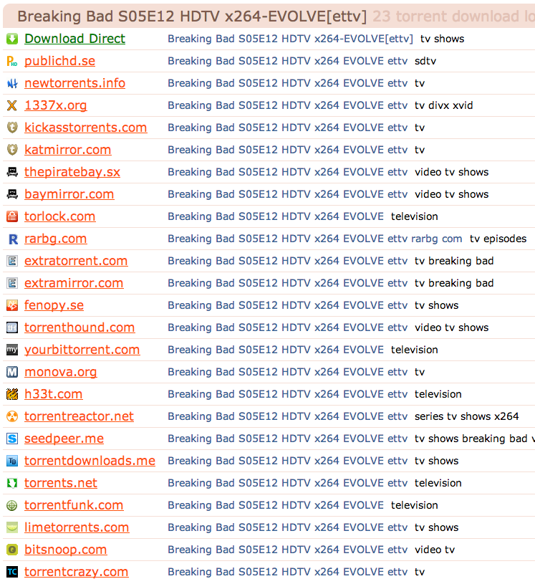
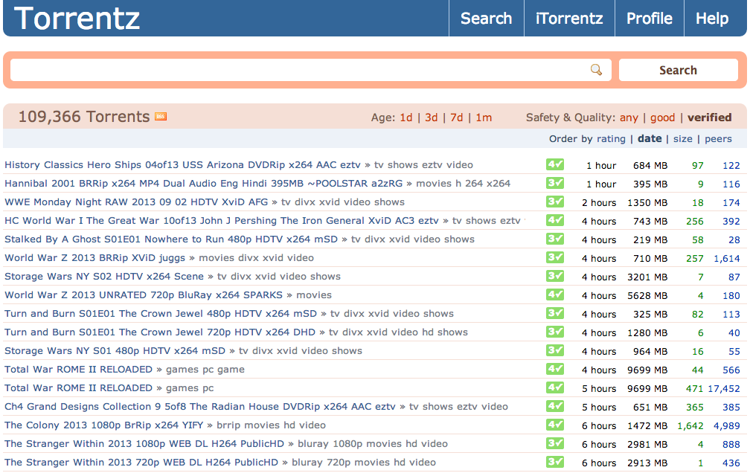
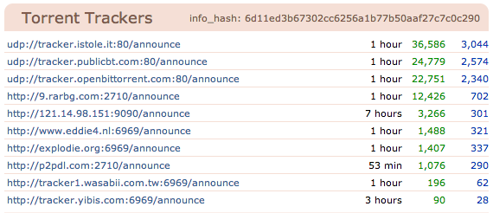
Torrent site diversity works against the user!
No overlap
extratorrent.com users cannot find torrentreactor.net peers
Torrent site choice limits to a subset of trackers and the peer population…
Solution: use all the trackers!

Slide 10
Some torrent sites are better than others
Best choice
Graph representation
1
Connected trackers are “co-listed” in a .torrent file
2
Each component is an isolated subset of the swarm population
Benefits of using all trackers:
More sources of peers
Access to more of the swarm, more local peers
Worst choice

Slide 11
More trackers = access to more of the swarm
20% of torrents: miss part of the swarm no matter what site used
Up to 50% increase!
Best choice
Worst choice
Notes:
Again, provide a bit of methodology for what we collect: 50 top torrents, study the tracker-search site graph & population size. Minimum/median/maximum correspond to the improvements depending on search site chosen

Slide 12
Summary
Widespread locality exists
  50% of networks have 5+ local peers
  Time-of-day is a key factor: 200% locality increase during peak hour
Client-side modifications improve discovery rate by >100x
Using all trackers is essential to discover available locality
These techniques boost the efficacy of end-host-based biased neighbor selection

Slide 13
Why we are still talking about locality
Sustainable growth requires efficient use of resources
  local copies of content offload the network
When systems ossify or are beyond our control, we…
  cope as best we can
  build on top – end-host solutions

